Slide 1
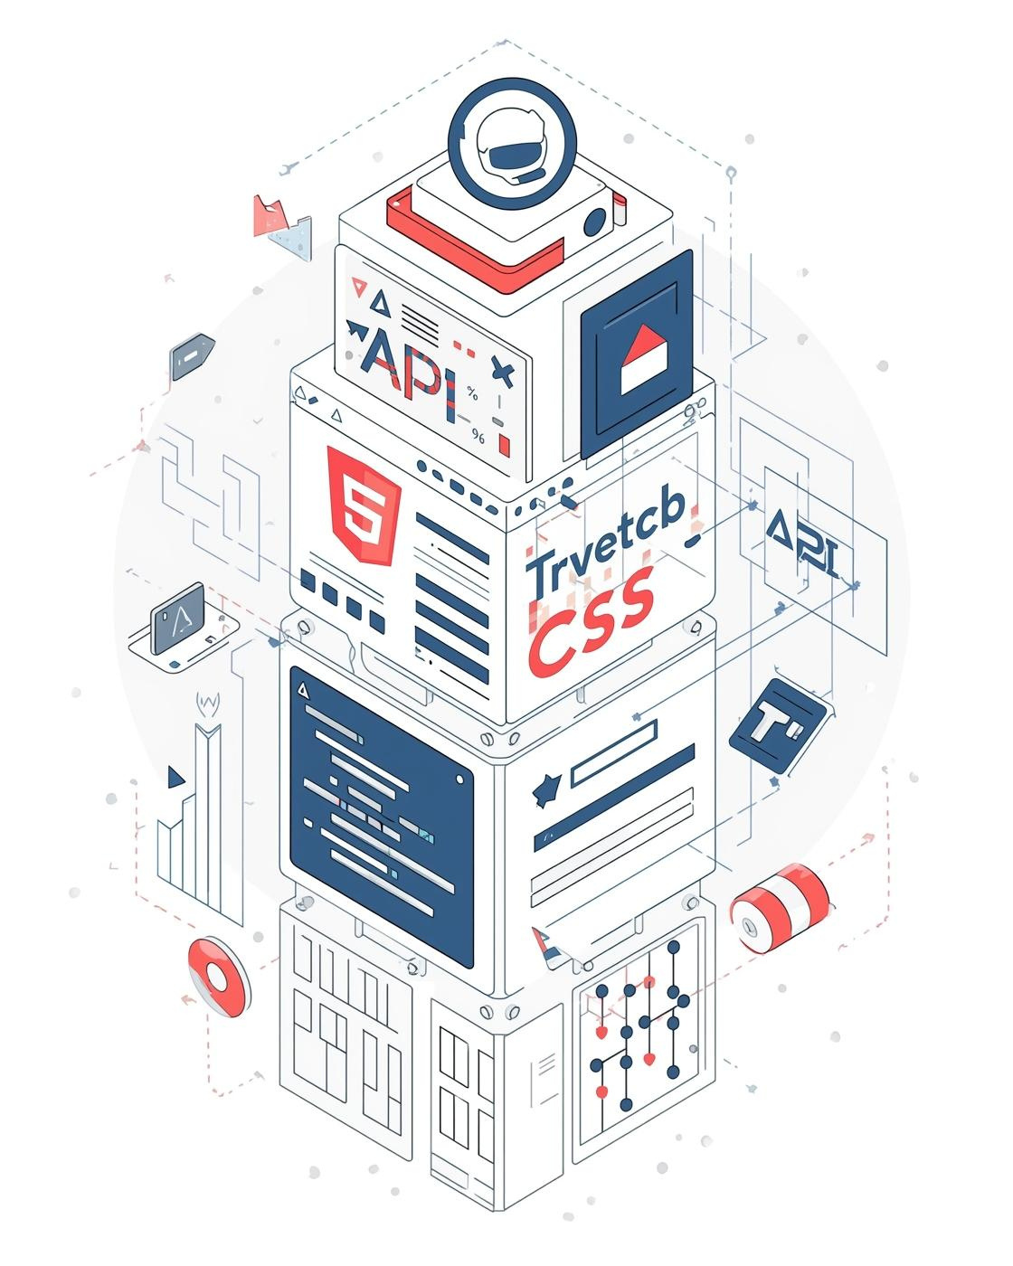
Overview of Development Tools
Full Stack Development Tools
Shree Skanda V
Raghav Singh Rajpurohit
CITY ENGINEERING COLLEGE
08/10/2025

Slide 2
Full Stack Development Tools Overview
Introduction to Full Stack Tools
Mastering full stack development tools like Postman, Eclipse, and MySQL is essential for modern developers, enabling seamless interaction between frontend and backend while ensuring robust application performance.
Importance of API Testing
Tools like Postman facilitate efficient API testing, ensuring backend services function properly. This process is crucial for maintaining application integrity during development and deploying reliable software solutions.
Role of Version Control
GitHub serves as a vital platform for version control and collaboration, allowing teams to manage code effectively, track changes, and facilitate teamwork in software development projects.
TOOLS FOR SUCCESS
2

Slide 3
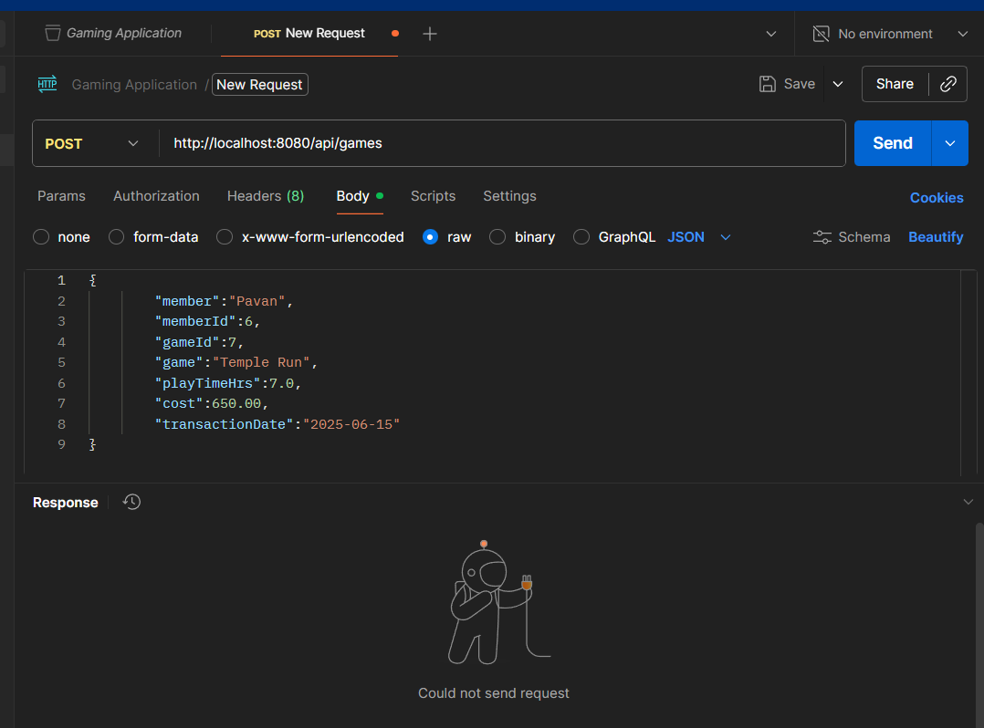
Postman: Your API Development Companion
Understanding the Role of Postman in Modern Development
Postman serves as a vital tool for API testing and development, allowing developers to create, send, and analyze HTTP requests with ease. Its user-friendly interface enables seamless organization of requests, while features like collections and environment variables streamline testing workflows. Mastering Postman can significantly enhance the efficiency and effectiveness of backend development processes.
POSTMAN OVERVIEW
3

Slide 4
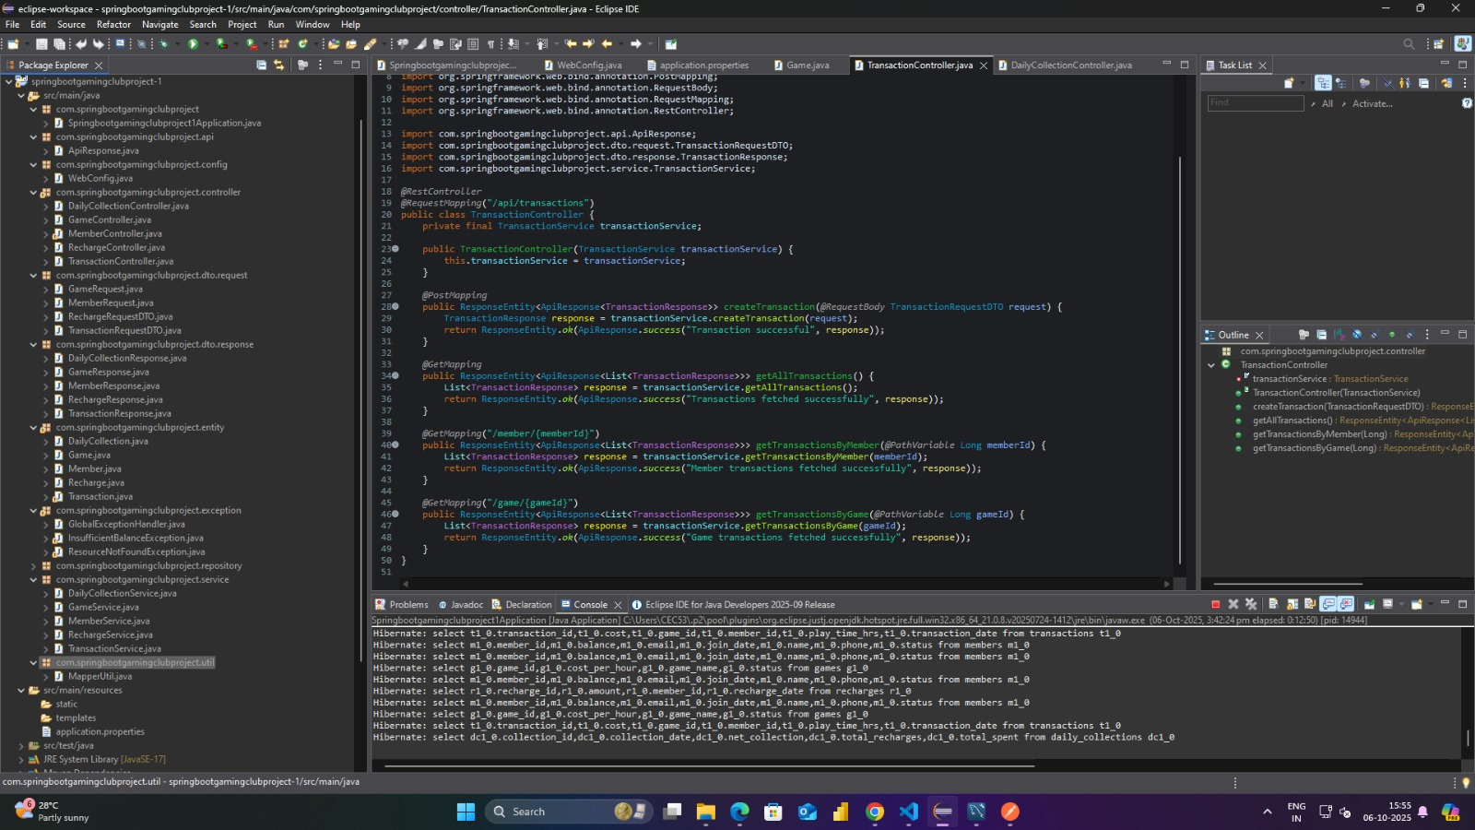
Integrated Development Environment for Java Development
Explore how Eclipse enhances Java coding efficiency and project management
Eclipse is a powerful Integrated Development Environment (IDE) tailored for Java development. Its features include an intuitive code editor, debugging tools, a versatile plugin ecosystem, and project management capabilities, making it an essential tool for developers. Eclipse streamlines coding, enabling more efficient management of backend application logic in projects like the Employee Management System.
ECLIPSE OVERVIEW
4

Slide 5
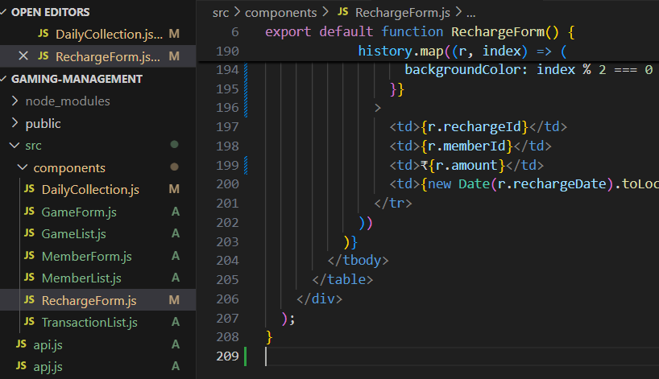
Understanding Java's Role in Backend Development
Exploring the importance of Java in the Employee Management System project
Java is the backbone of our backend logic, providing a robust and object-oriented programming environment. Its rich set of libraries and portability make it ideal for developing scalable applications. Through integration with tools like Eclipse and MySQL, Java facilitates seamless data handling and execution of business logic, ensuring efficient employee management.
JAVA OVERVIEW
5

Slide 6
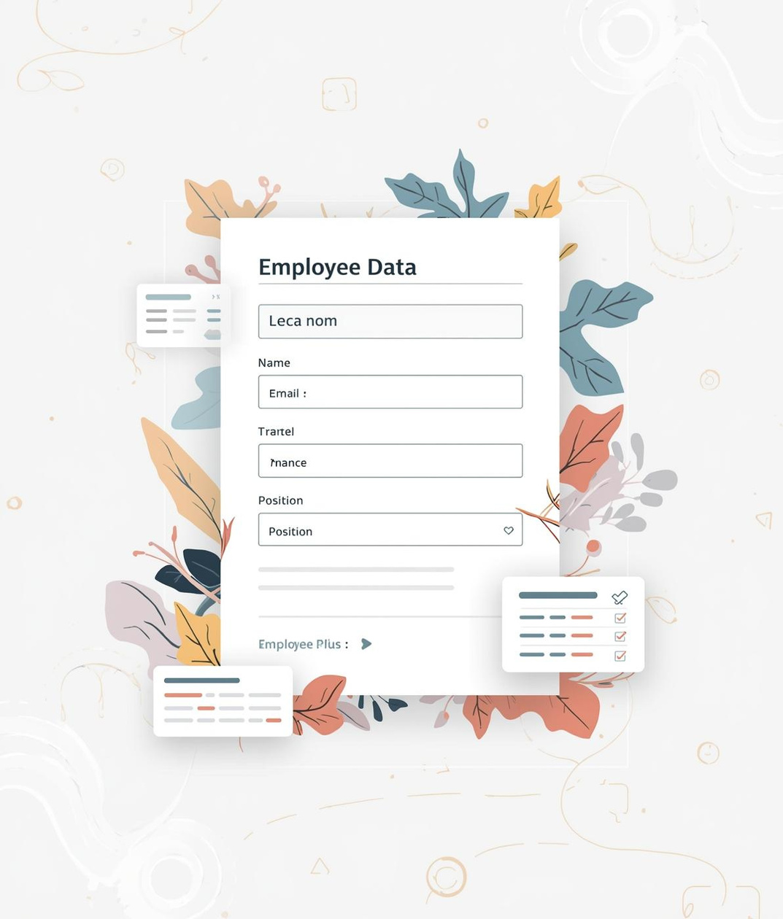
Frontend Tools: HTML & CSS
Crafting User Interfaces for Modern Applications
HTML and CSS are the cornerstones of web development, providing structure and style to user interfaces. HTML creates the framework for content, while CSS enhances it with aesthetic appeal. Together, they enable developers to build responsive, engaging web pages that connect seamlessly with backend services, enhancing user experience.
FRONTEND DEVELOPMENT
6

Slide 7
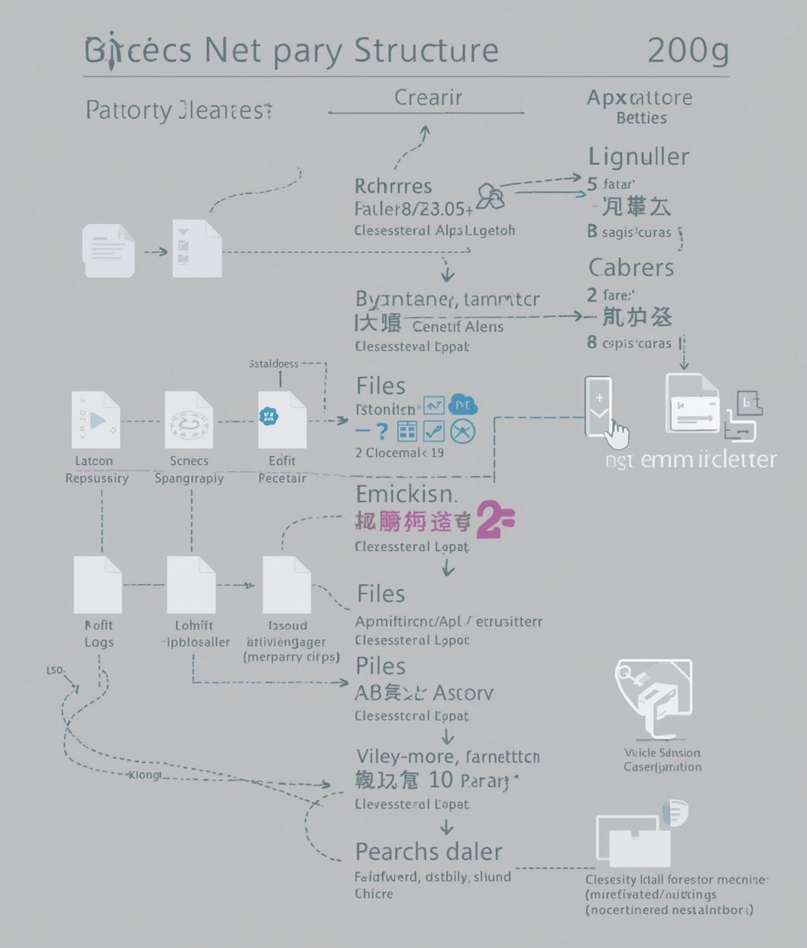
Streamlining Version Control with GitHub
Collaborating on code: Essential features and benefits
GitHub serves as a crucial platform for version control and collaboration in software development. It enables teams to manage source code efficiently, track changes, and support seamless collaboration through features like branching and pull requests. By utilizing GitHub, developers can ensure their projects remain organized and maintain deployment readiness throughout the development lifecycle.
GITHUB OVERVIEW
7

Slide 8
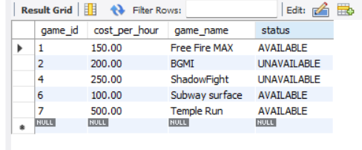

Understanding MySQL as a Relational Database
Exploring the role of MySQL in data persistence for applications
MySQL serves as the backbone of the Employee Management System, storing critical employee details in structured tables. By utilizing SQL queries, developers can efficiently manage and retrieve data, ensuring data integrity and efficient access. Understanding MySQL enhances your ability to create robust applications that rely on reliable data storage solutions.
MYSQL OVERVIEW
8

Slide 9

Integrating Tools for the Game Members Management System
Understanding how each tool contributes to the project workflow
The Employee Management System demonstrates how tools like HTML, Java, Postman, GitHub, and MySQL work together. The frontend interfaces connect to backend logic, while API testing ensures smooth interaction. Version control via GitHub tracks changes, and MySQL stores data efficiently, creating a robust development environment.
TOOL INTEGRATION OVERVIEW
9

Slide 10
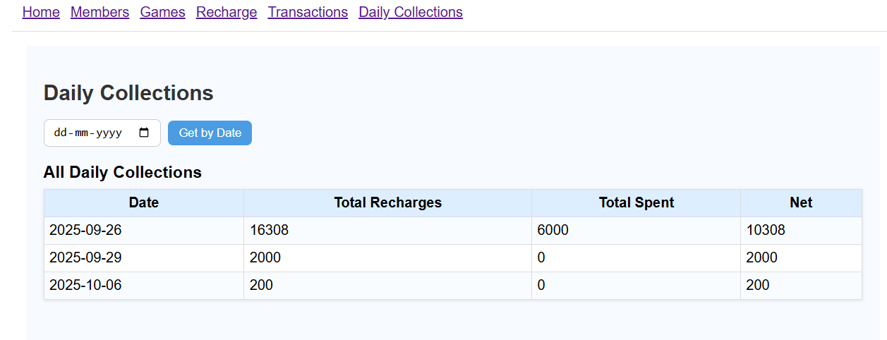
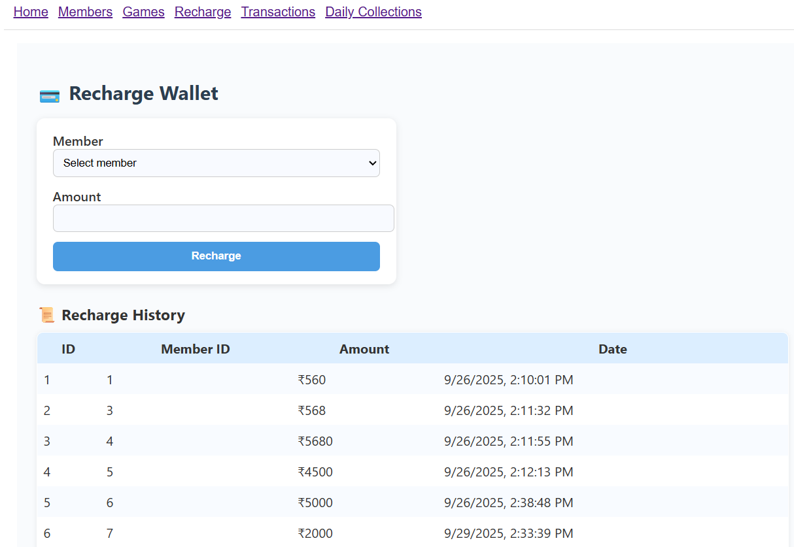
Integrating Tools for the Game Members Management System
An web-based application exhibiting CRUD operations whose role is to keep the track of games to which an end users had enrolled himself and providing the access to the game based on a subscription process.
This application or project provides the following services:
->Adding an member and the game he/she wants to play
TOOL INTEGRATION OVERVIEW
10

Slide 11

Key Takeaways on Full Stack Development Tools
Understanding essential tools for building modern applications
Mastering full stack development tools is crucial for software development success. From Postman for API testing to Eclipse for Java coding, each tool plays a vital role. Emphasizing integration between frontend and backend technologies strengthens project execution and enhances collaboration, ensuring efficient workflows and robust application development.
FULL STACK DEVELOPMENT TOOLS
11

Slide 12
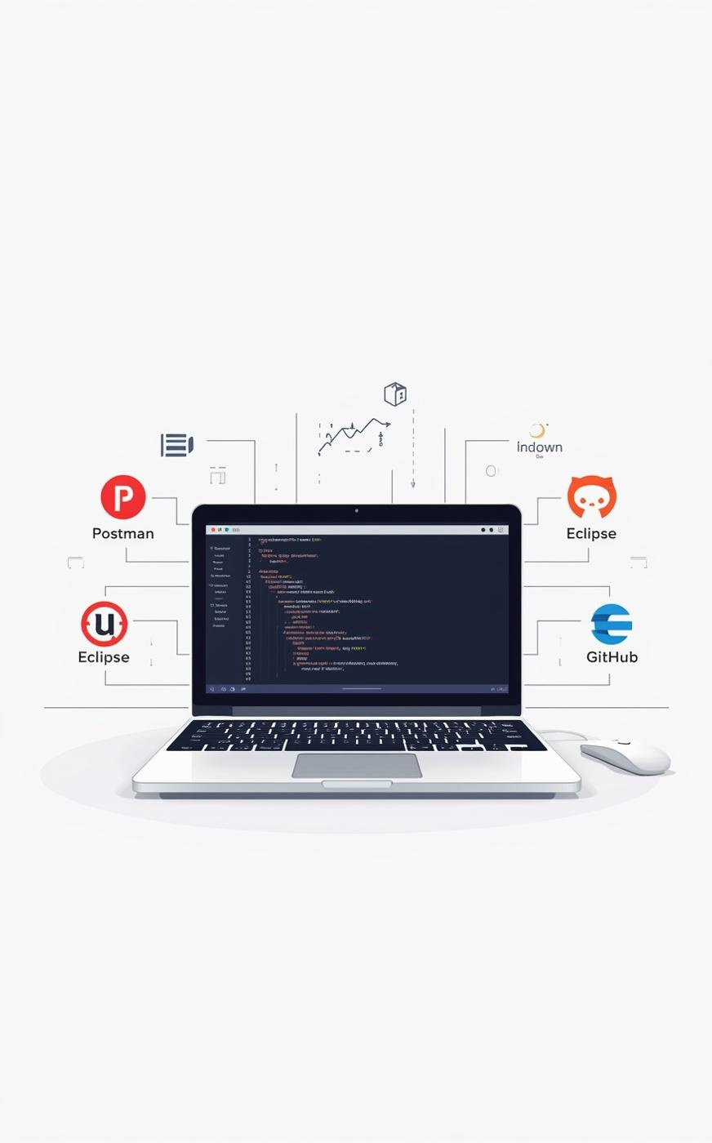
Q&A and Contact Information
Explore Full Stack Tools Hands-on with the Employee Management System example.
Phone Number
123-456-7890
Email Address
hello@reallygreatsite.com
Website URL
www.reallygreatsite.com

Slide 13
THANK YOU

